Slide 1
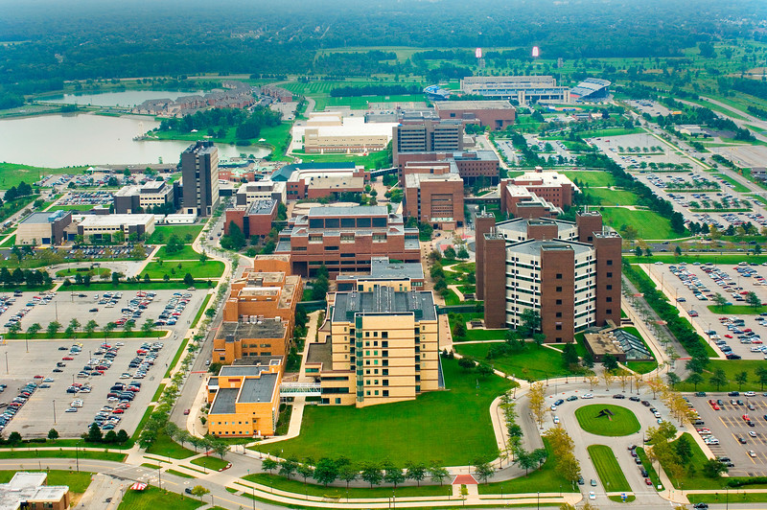
University at Buffalo Tours
Presented by: Courtney Cheuk, Eric Manser, Bridget Mensah, Joseph Reed

Slide 2
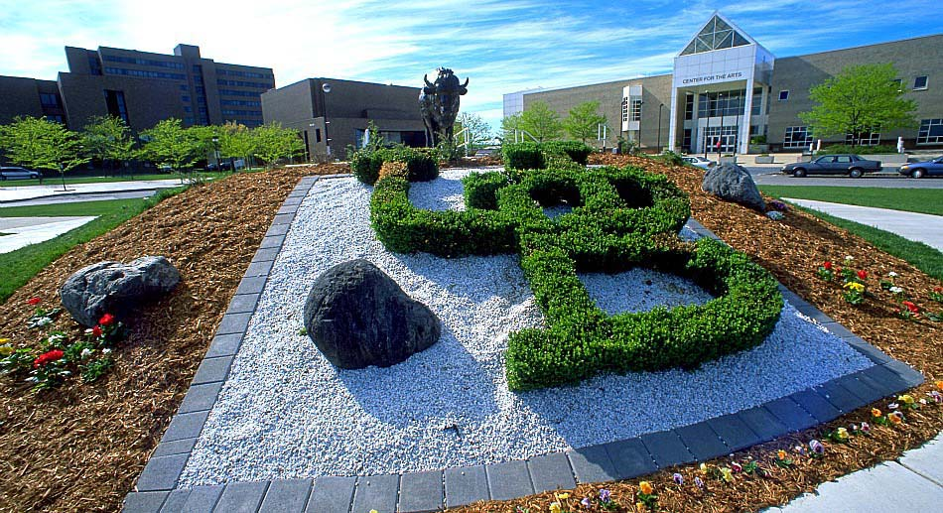
Background of Project

Slide 3
Business Value
Personalized experience
Credibility
Ease of access

Slide 4
Database Design Overview
Tables
Queries
Forms
Reports
Macros

Slide 5
User Interface Design
Efficient navigation
Accessibility
User friendly

Slide 6
Project Demonstration

Slide 7
Conclusion

